Slide 1
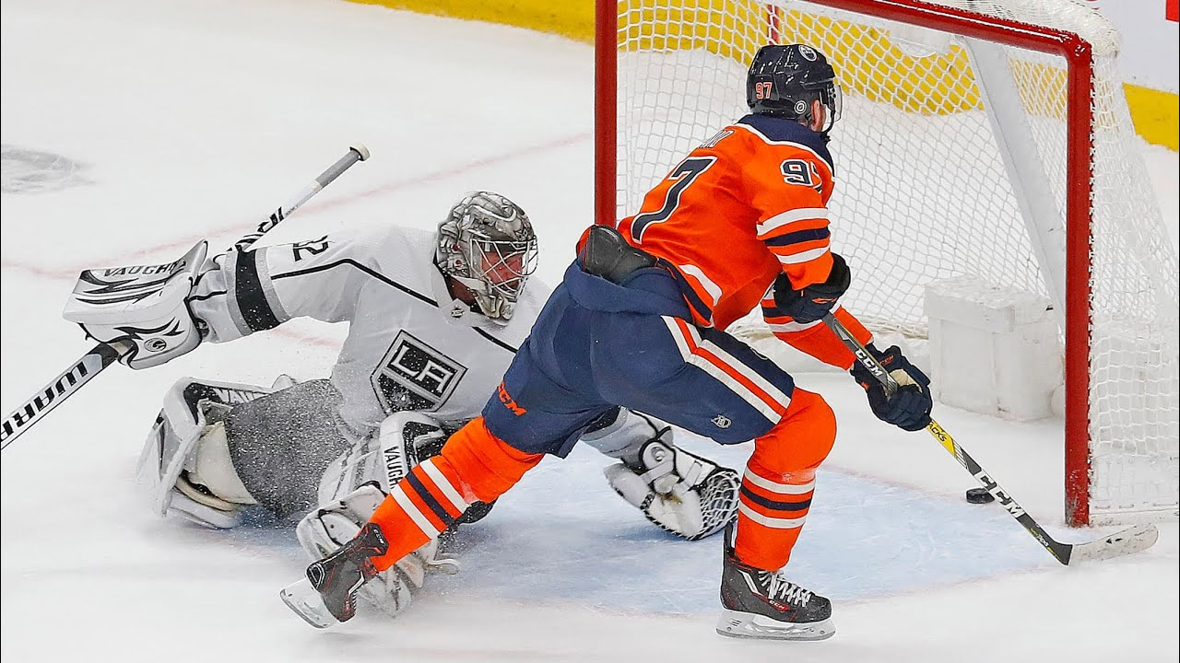
NHL Power Play Goals
Analysis presented by: Benett Dervishaj and Andrew Fish
SAL 608
Video Link

Slide 2
Research Questions
What machine learning model best predicts power play goals?
  What factors influence power-play goals?
  How does shot quality change as power play continues?
  What are the goal totals per team?
  What is the predicted power play percentage based on the best model?

Slide 3
Data
NHL play-by-play data
  2023-24 Regular Season
  Game, Team, and Player
Filtered into Shots, Penalties, and Faceoffs
  Lined up identifier variables to clean data
    Remove coincidental penalties, calculate Power Play Goals and Power Play Time Remaining
Fully cleaned data for predicting Power Play Goals
  Period, Seconds Remaining in Period, Power Play Skaters, Penalty Kill Skaters, Power Play Team, Home Power Play, Score Differential, Penalty Minutes, Shots on Goal

Slide 4
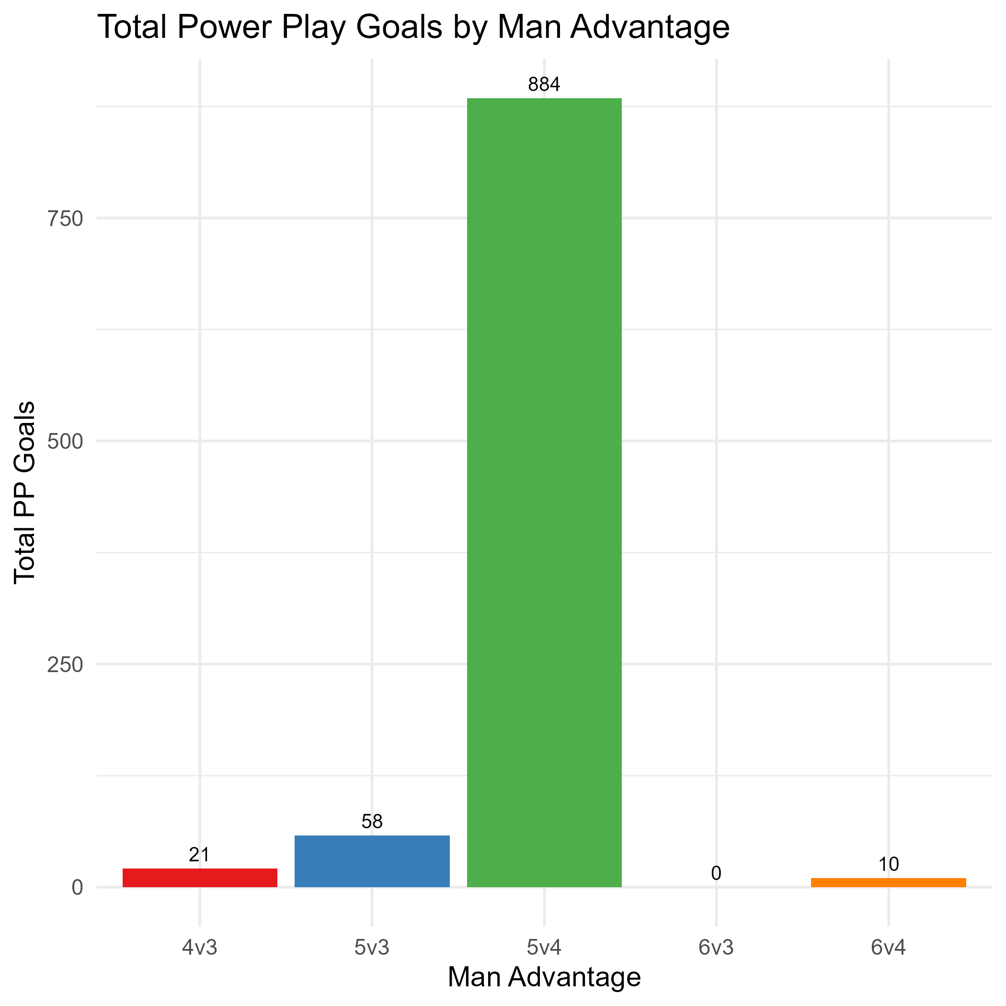
Investigating the Data

Slide 5
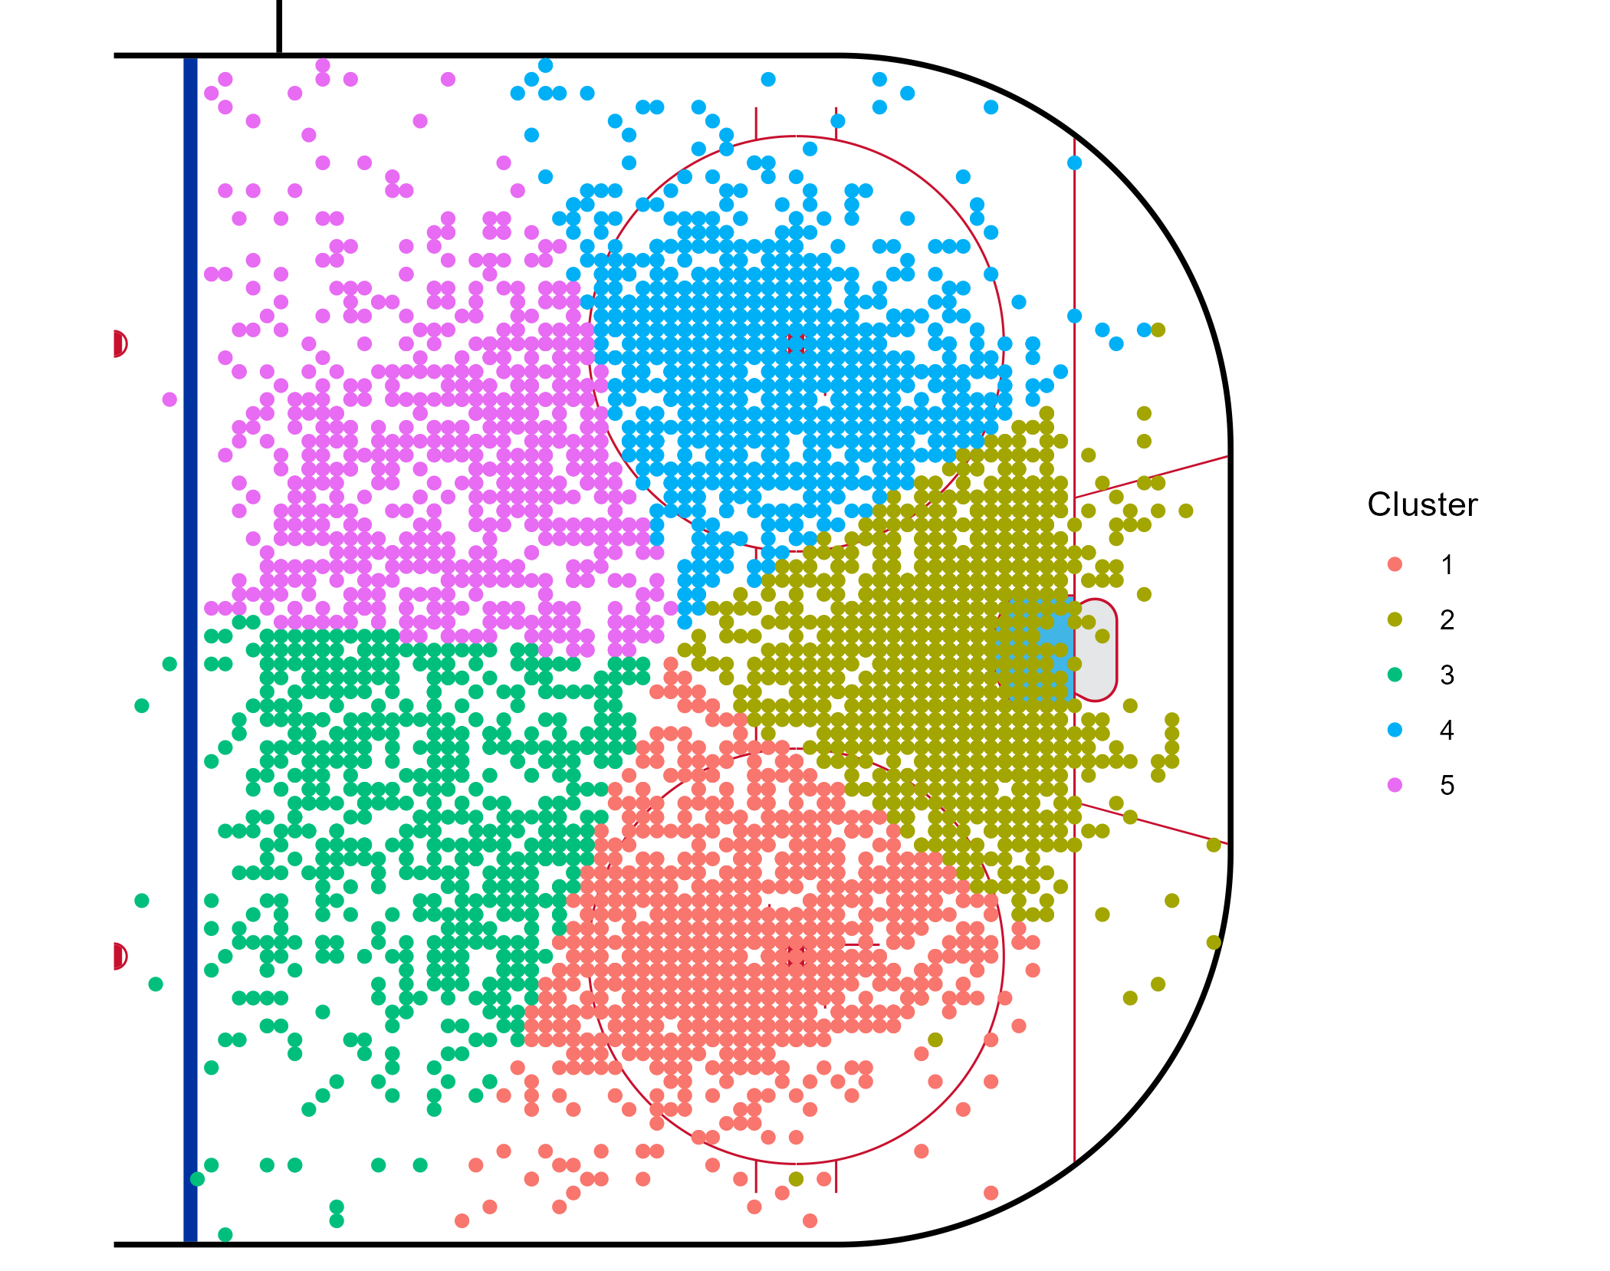
Shot Analysis
Clustering of all Power Play Shots on Goal
Overload v Umbrella
Does the quality of Shots on Goal change with time?

Slide 6
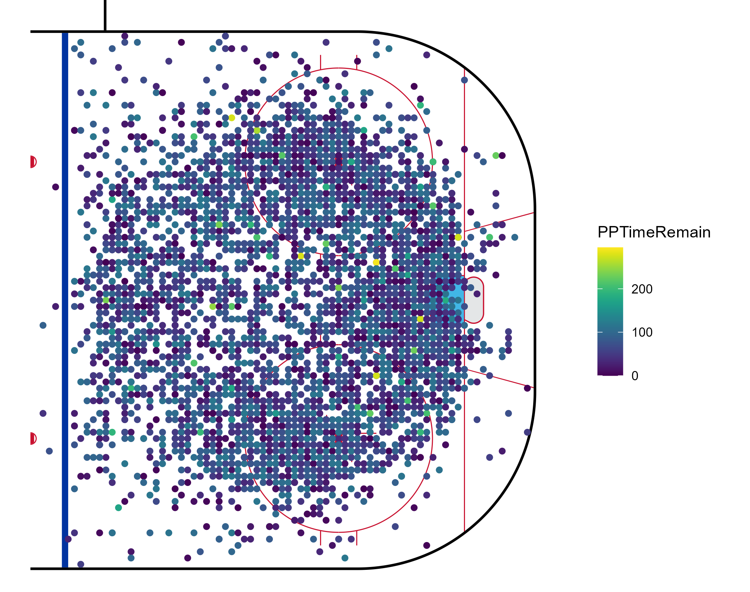
Shots Over Time
Short Answer
  No
Long Answer
  Depends on the game situation
  Set plays
  Power Play set-up

Slide 7
Modeling
Three models
Logit, Probit, and XGBoost
Predictors
Period, Seconds Remaining in Period, Power Play Skaters, Penalty Kill Skaters, Power Play Team, Home Power Play, Score Differential, Penalty Minutes, Shots on Goal
Evaluation Metrics
Brier Score and Accuracy

Slide 8
Logit and Probit Regression
See R Model summary in Appendix A
Key Findings:
  Significant at 1%:
    Penalty Kill Skaters
    Shots on Goal
    Tampa Bay Lightning
  Significant at 5%:
    Chicago Blackhawks
    Dallas Stars
    Florida Panthers
    St. Louis Blues
    Washington Capitals
  Significant at 10%:
    Arizona Coyotes
    Colorado Avalanche
    Minnesota Wild
    Penalty Minutes

Slide 9
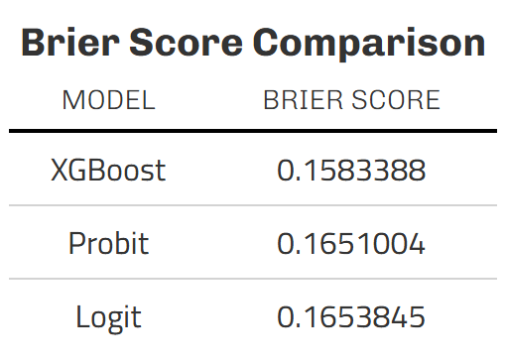
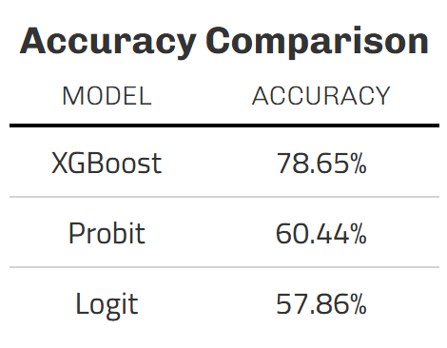
Model Comparison

Slide 10
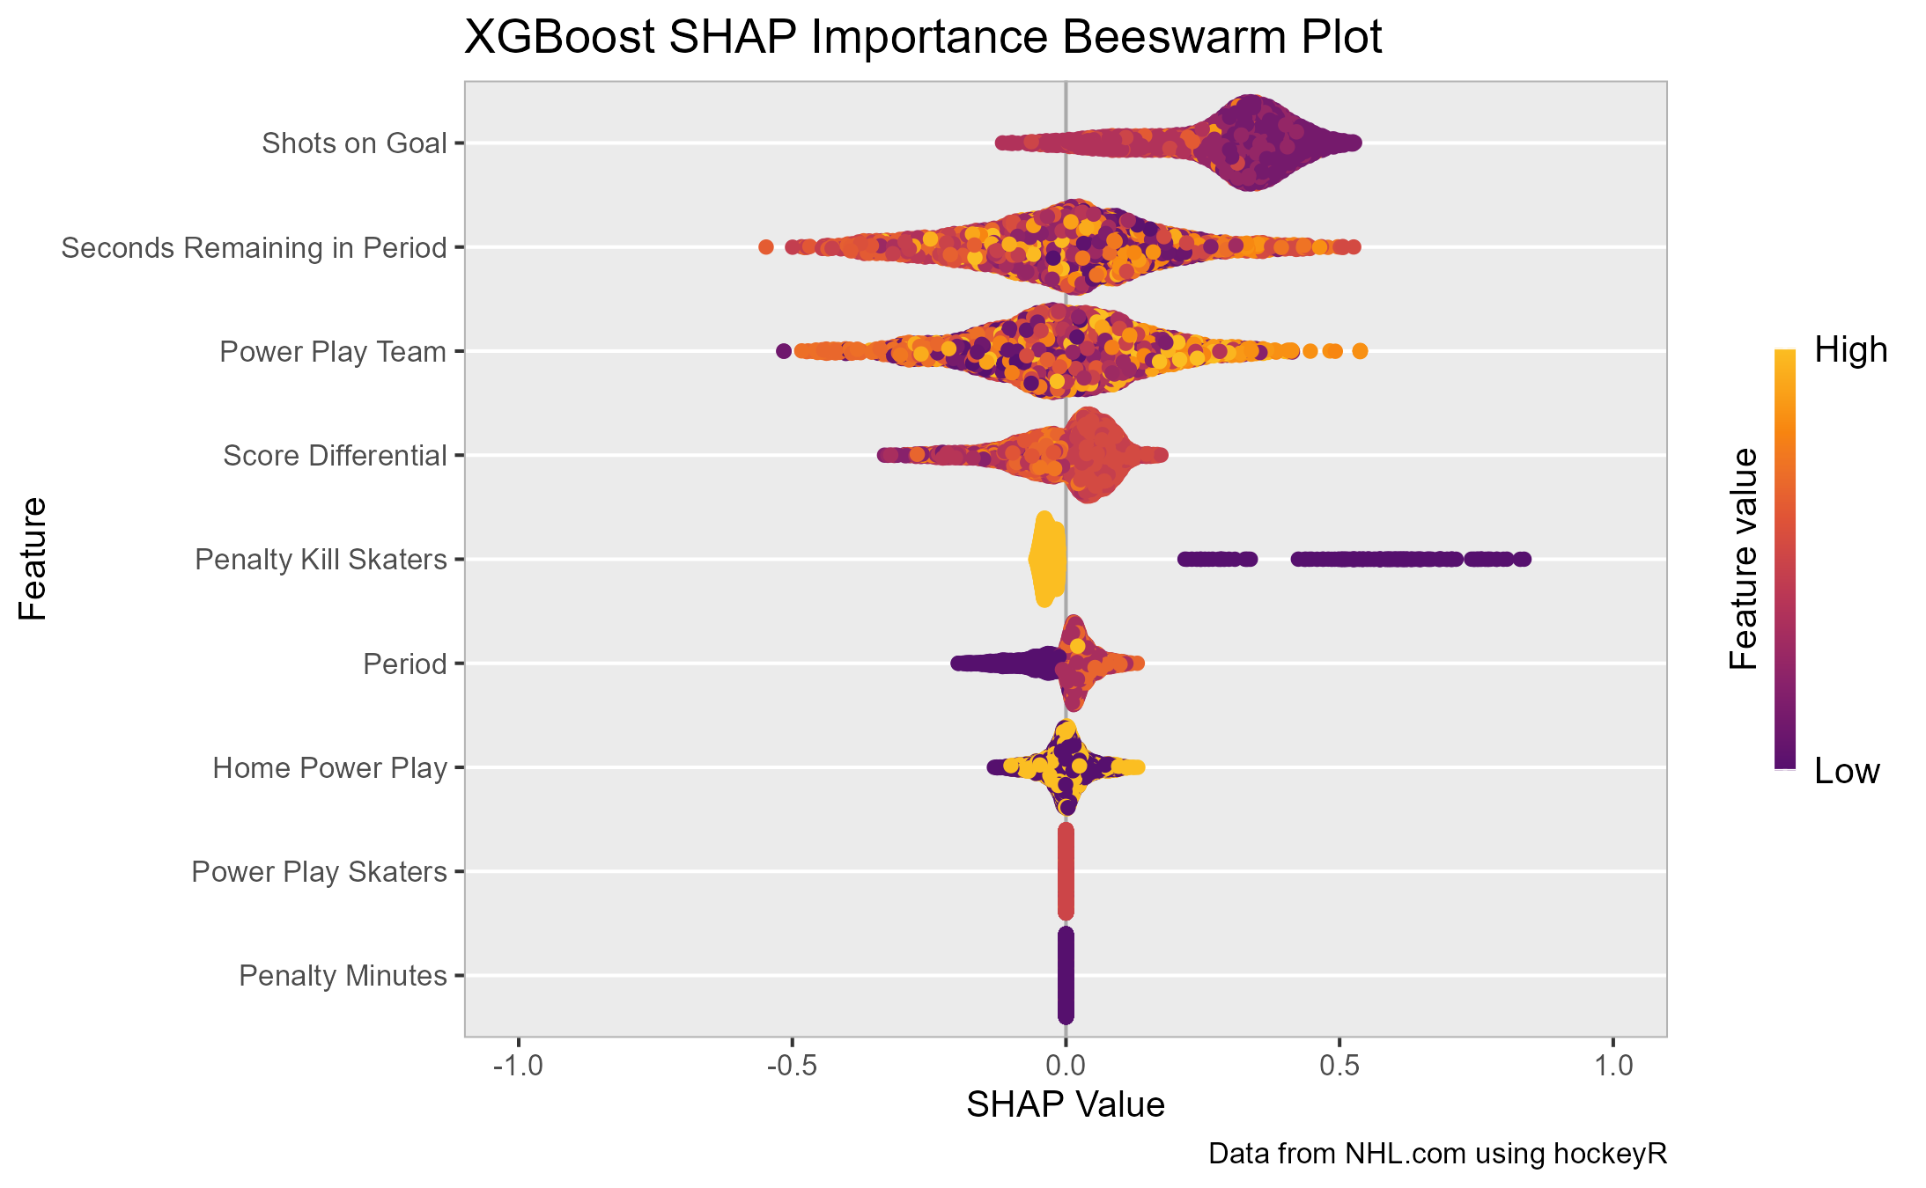
Variable Importance Using SHAP

Slide 11
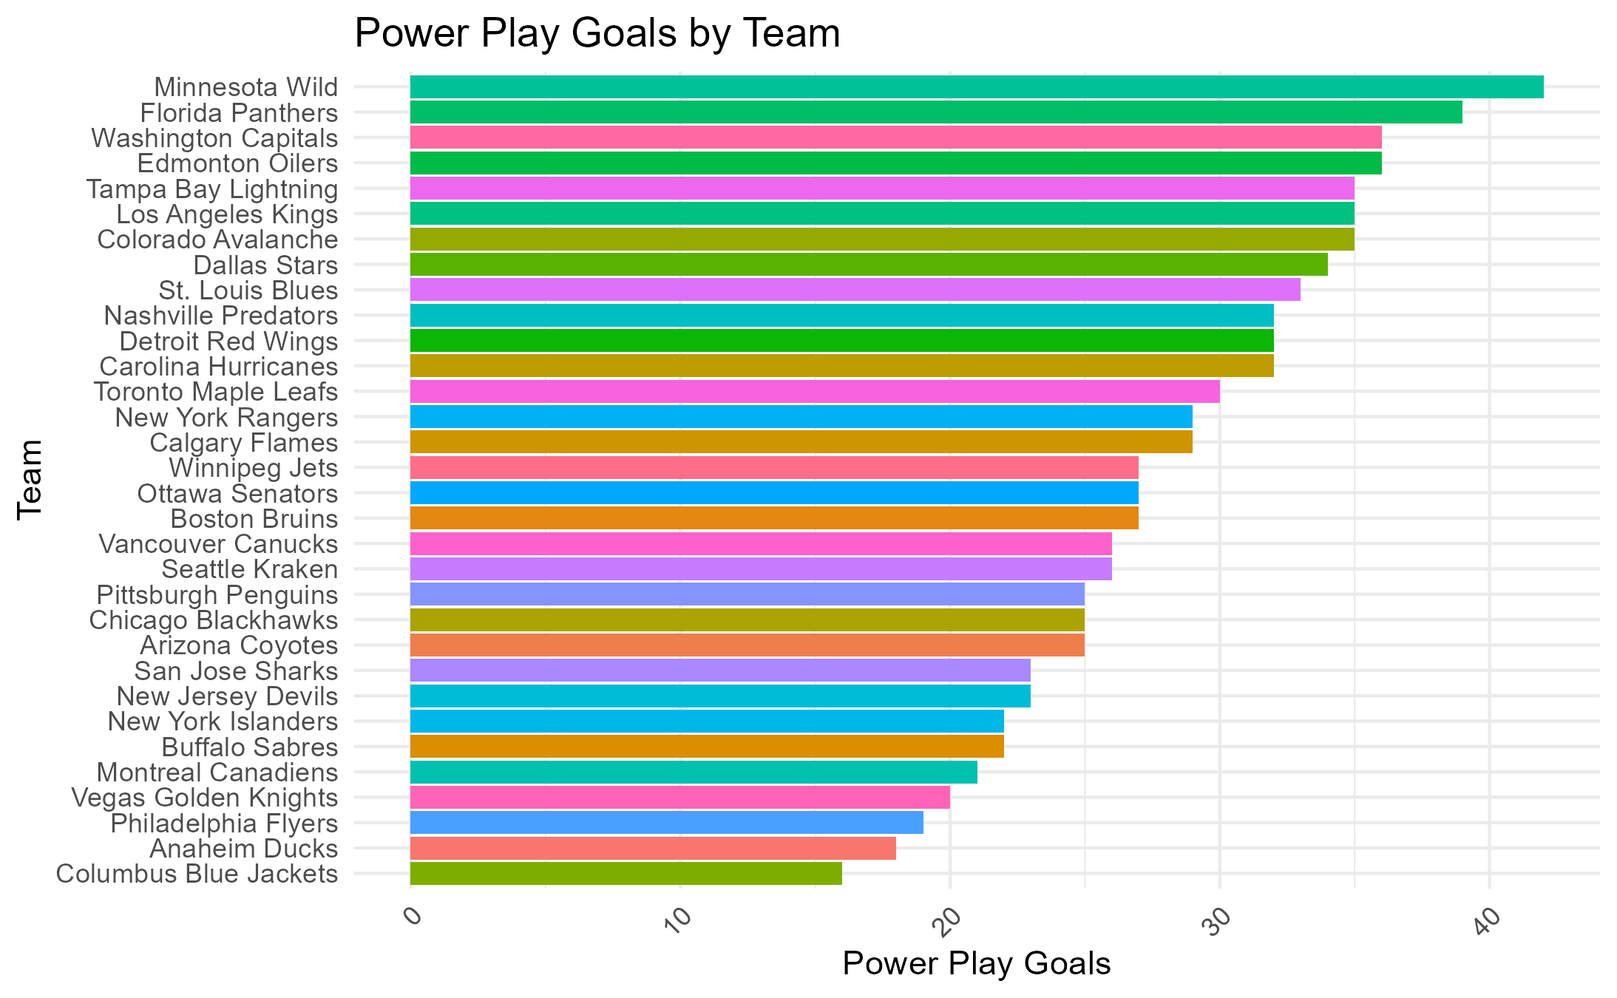
Power Play Goals by Team
League Leaders:
  Minnesota Wild: 40+ goals
  Florida Panthers: 35+ goals
  Washington Capitals: 30+ goals
Correlation to Win/Loss?
  Minnesota Wild: 39-34-9
  Florida Panthers: 52-24-6
    Stanley Cup Champions
  Washington Capitals: 40-31-11

Slide 12
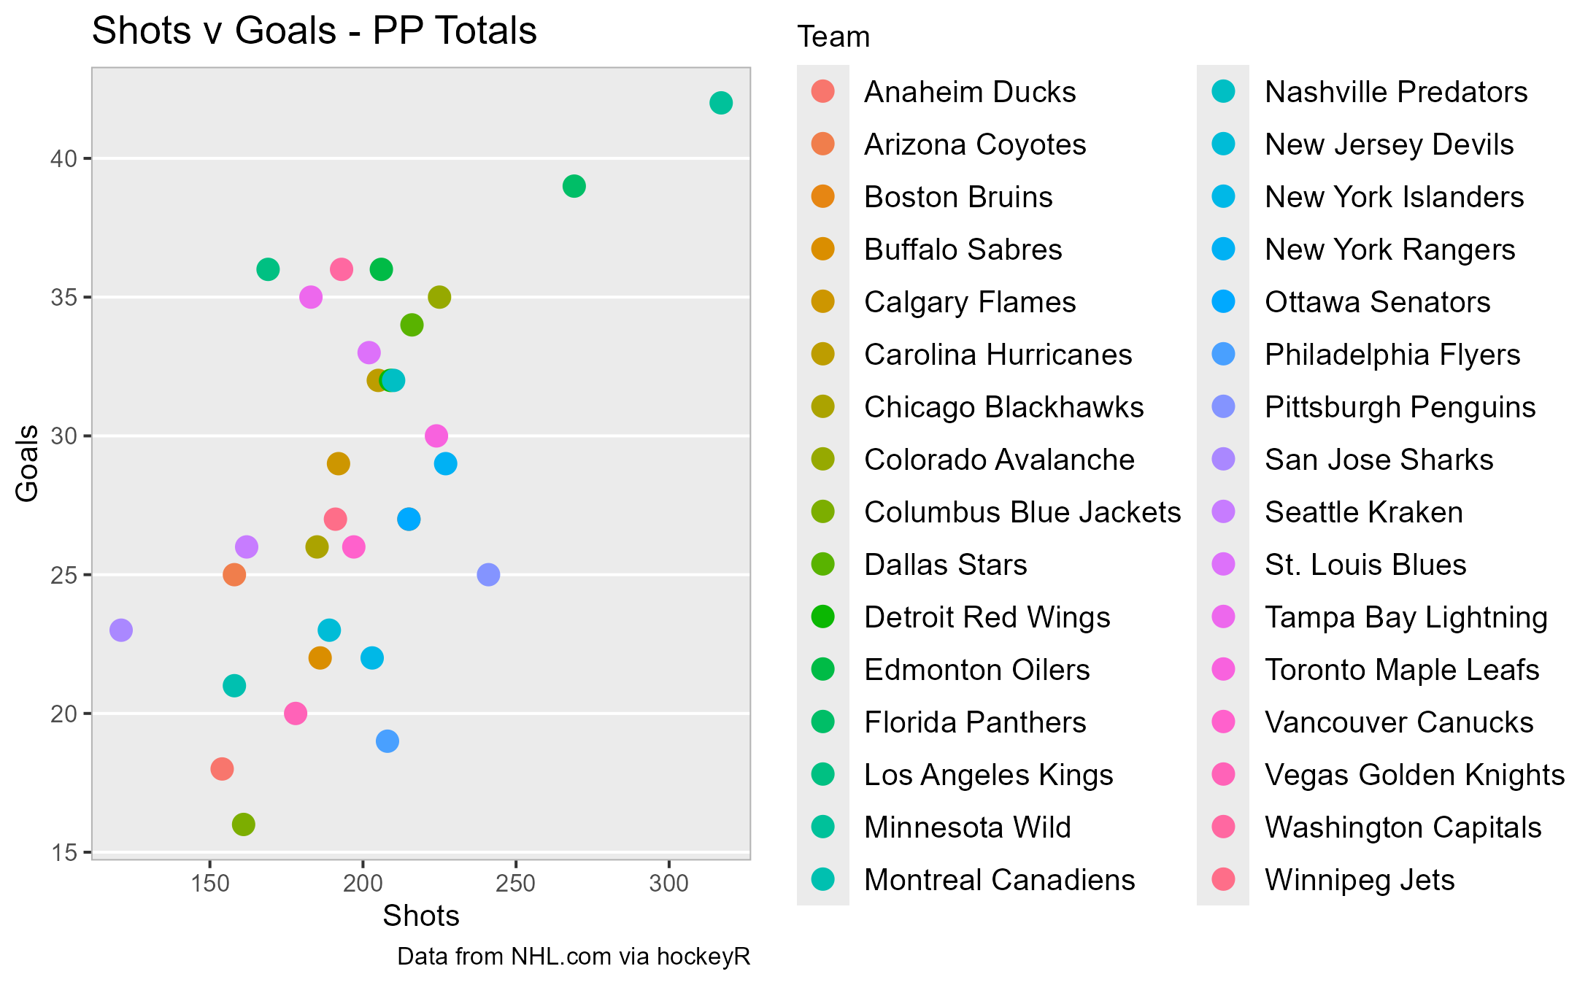

Slide 13
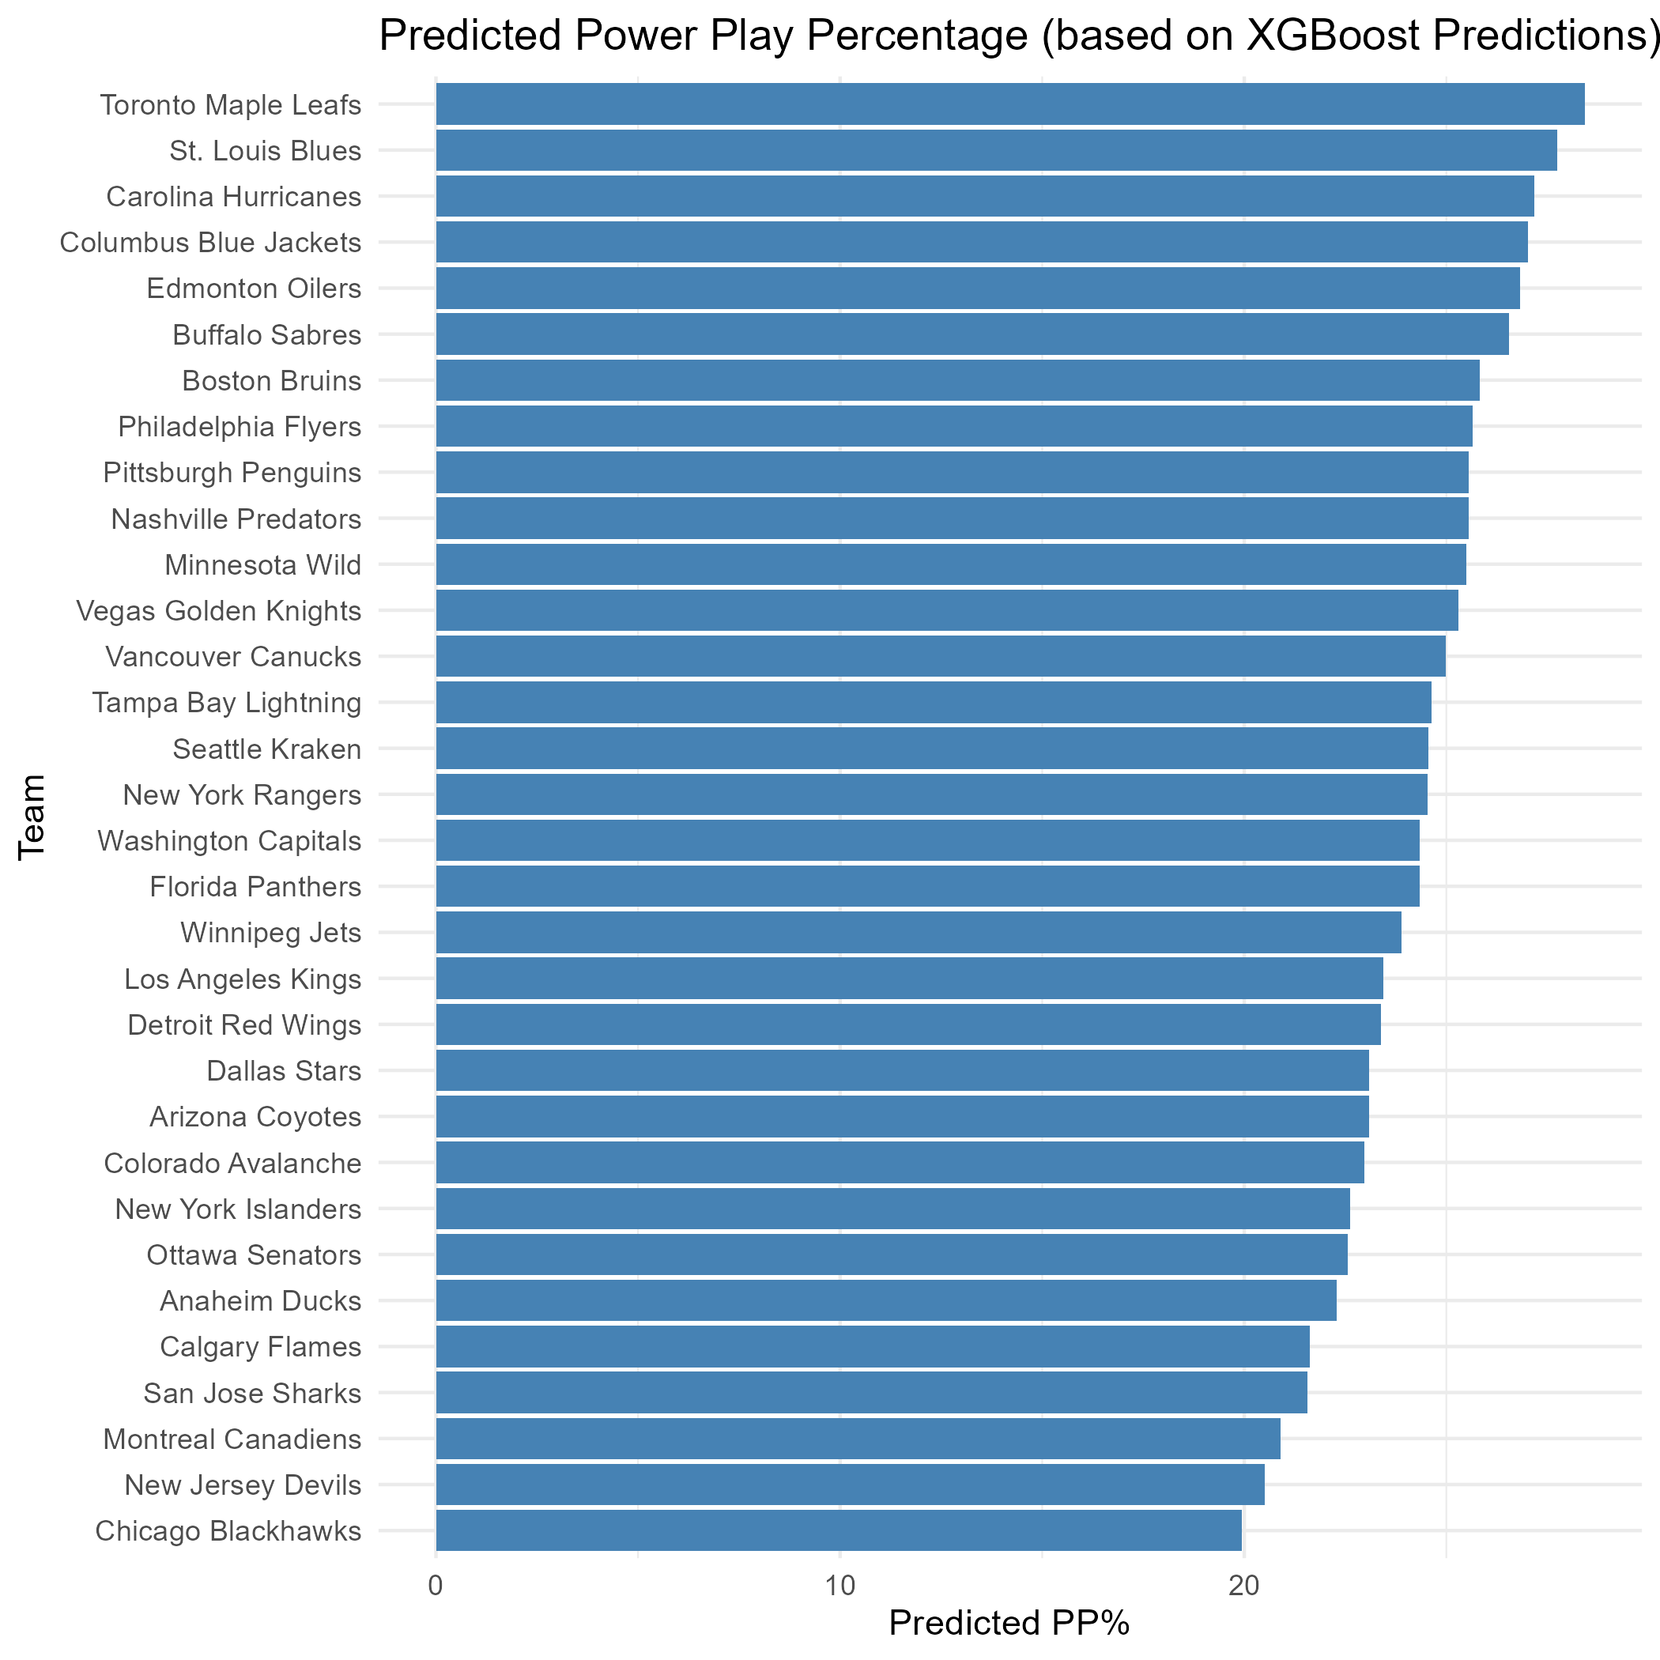
Power Play Percentage

Slide 14
Limitations and Further Research
Limitations
  Data
    Messy and missing values
Further Research
  Multiple Years
  Power Play Type
  Goal Cluster Analysis
    Penalty Kill Strategy

Slide 15
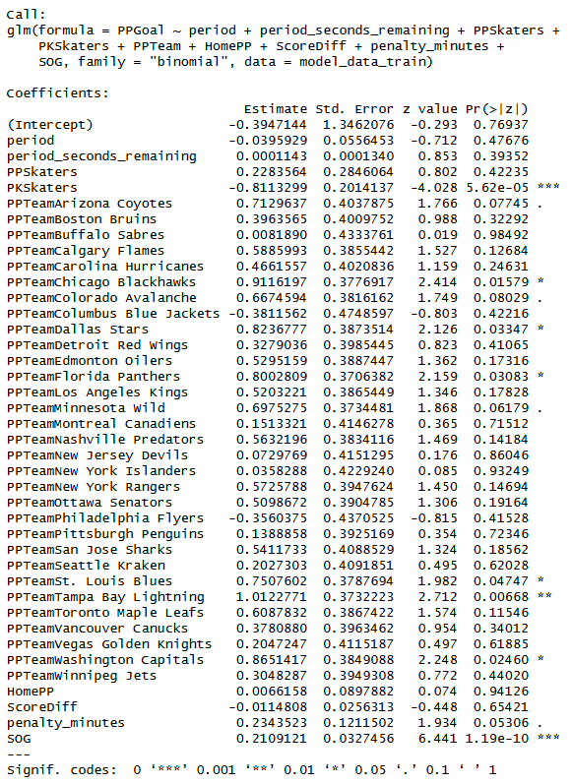
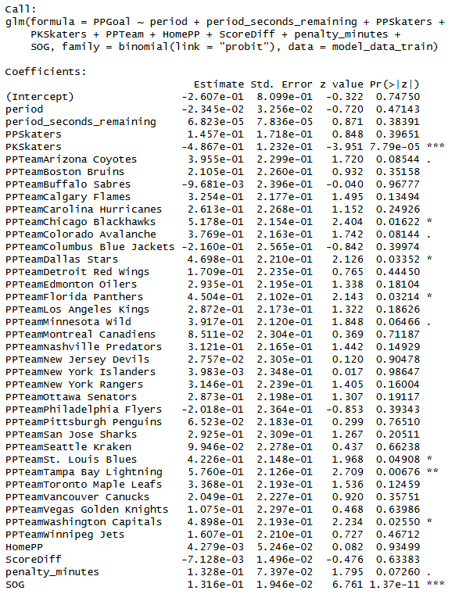
Appendix A
Logit
Probit

